Slide 1
Inject Commands to Servers

Slide 2
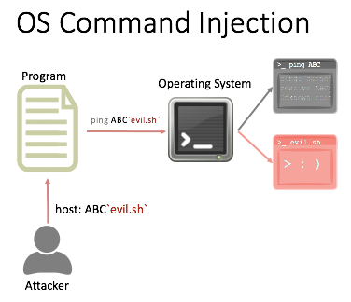

Slide 3
target information gathering

Slide 4
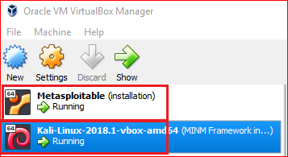

Slide 5
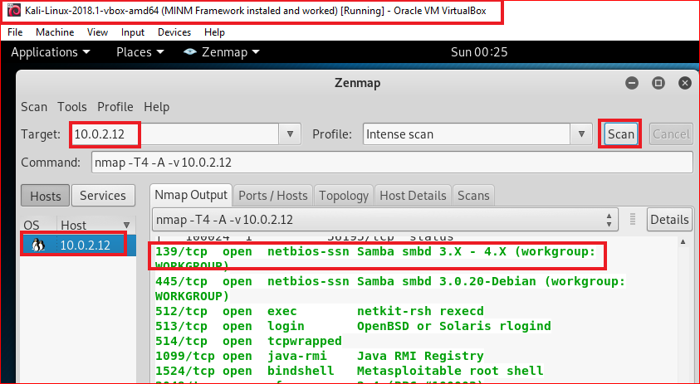

Slide 6
Search potential vulnerabilities

Slide 7
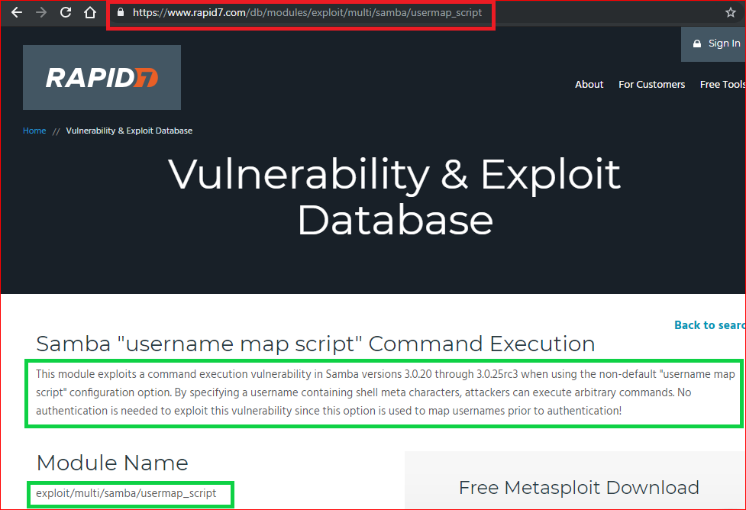

Slide 8
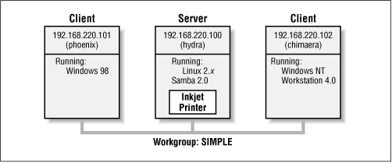
What is Samba?
Windows and Linux have difficulty getting along without mediation.
The goal of Samba (A software)
Samba runs on Unix platforms, but speaks to Windows clients like a native.
It allows a Unix system to move into a Windows "Network Neighborhood" without causing a stir.
Windows users can happily access file and print services without knowing or caring that those services are being offered by a Unix host.
https://www.samba.org/samba/docs/SambaIntro.html
https://www.oreilly.com/openbook/samba/book/ch01_02.html

Slide 9
What is Samba?
Use Common Internet File System (CIFS)
CIFS is a protocol suite
name was introduced by Microsoft
Server Message Block (SMB) protocol is one of CIFS
Created by Andrew Tridgell
He was contacted by a company claiming trademark on the name that he had chosen for his server software.
Used Samba instead

Slide 10
Inject commands to Samba

Slide 11
Injection details
Samba is running on servers
We inject arbitrary commands to Samba
Commands allow malicious users (e.g., Kali) to gain controls to the servers

Slide 12
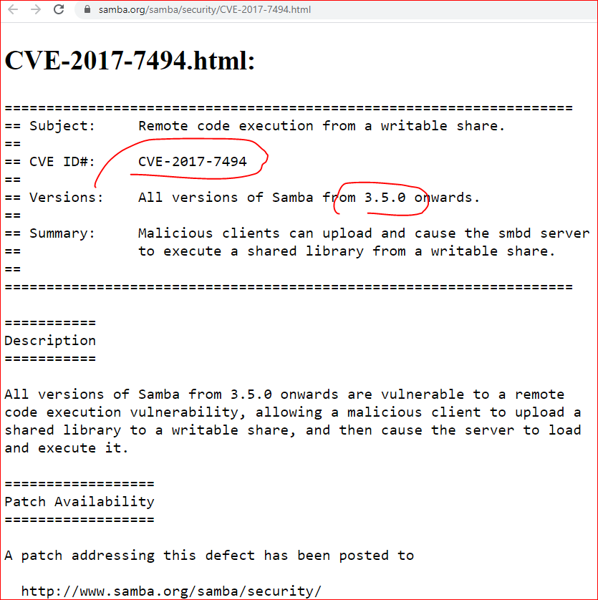
Injection details
https://www.samba.org/samba/security/CVE-2017-7494.html

Slide 13
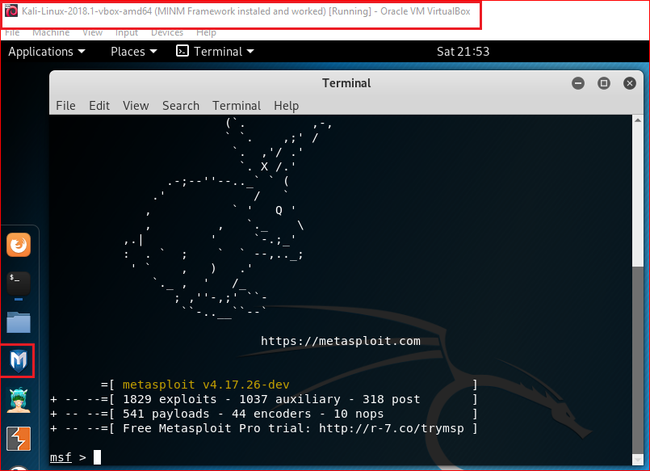
msfconsole
Notes:
Msf
consle

Slide 14
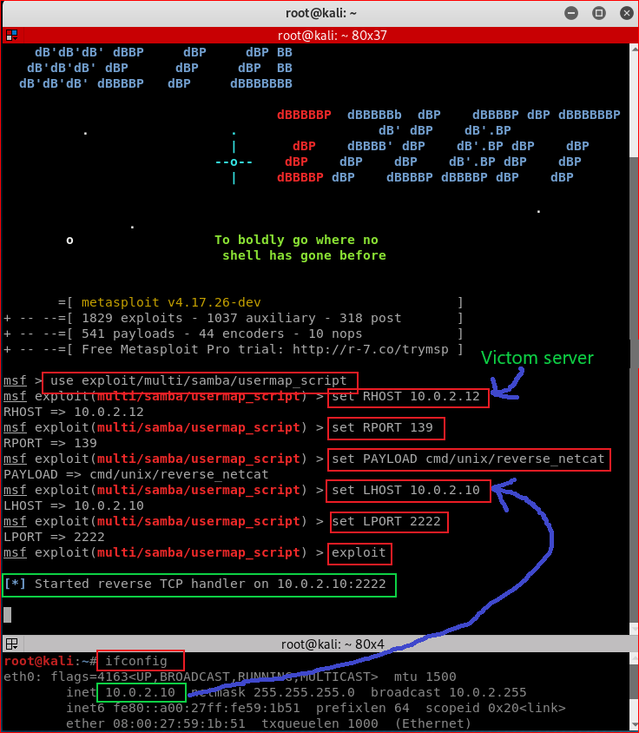

Slide 15
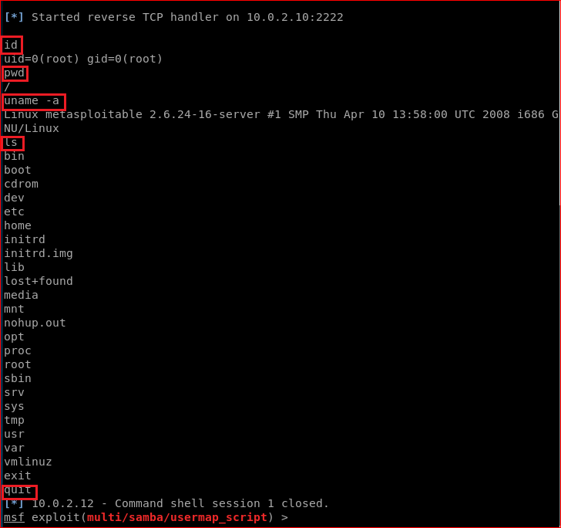

Slide 16
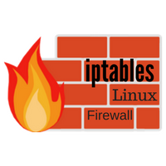
server side forensics using firewall

Slide 17
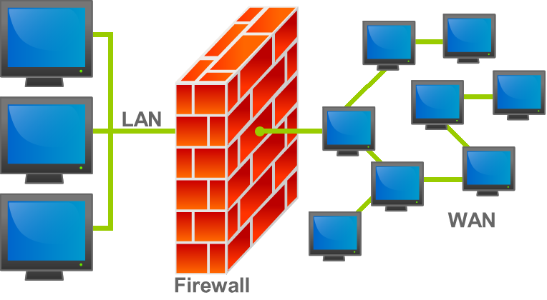
What is a firewall
https://en.wikipedia.org/wiki/File:Firewall.png

Slide 18
Create a rule for monitoring traffics
Your job is to find forensic evidence.
The evidence will tell us when intruder’s IP.

Slide 19
Reference
http://xahlee.info/linux/linux_iptables_basics.html
http://vault.centos.org/3.6/docs/html/rhel-rg-en-3/s1-iptables-options.html

